Slide 1
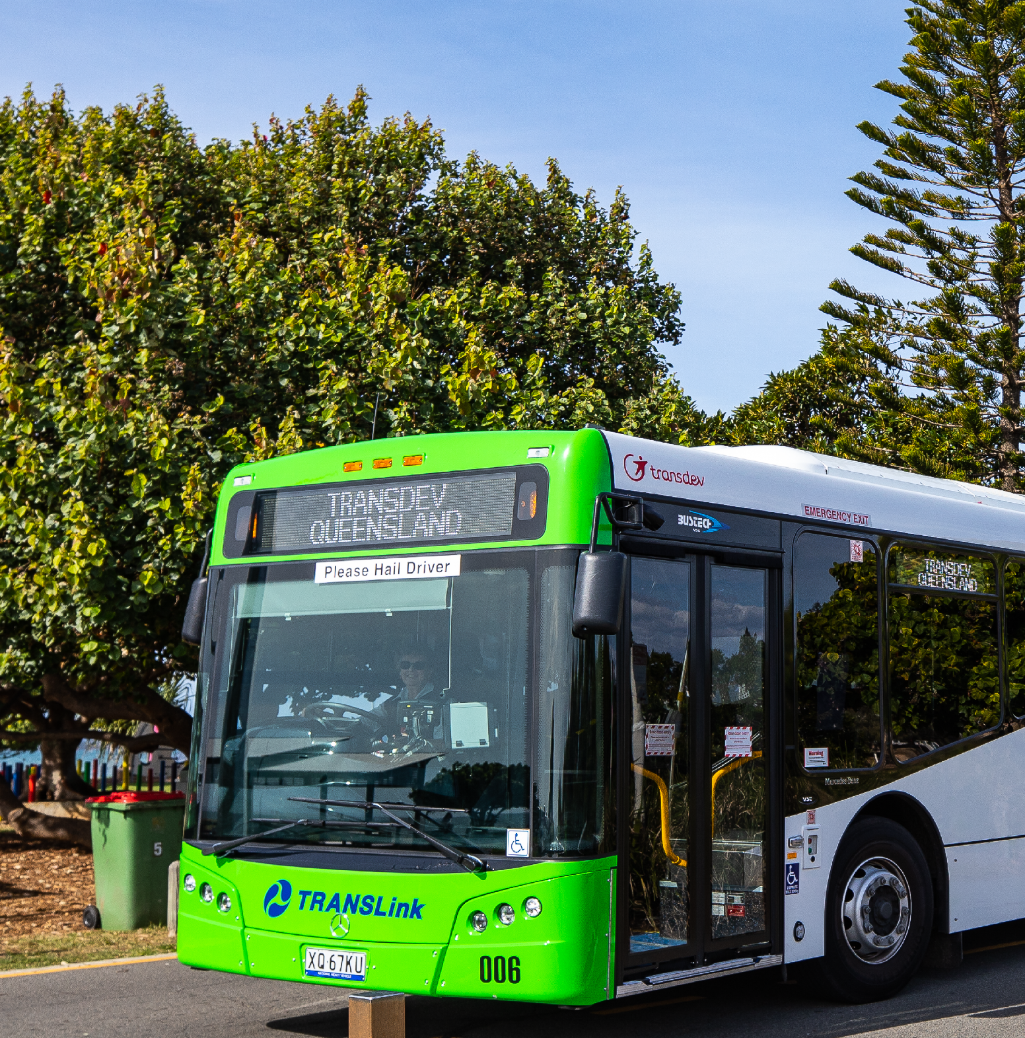

1. Select the photo you want to change,
double click here:
2. Right click > select change picture and
select your profile image
3. Click off the image
4. Reselect the image group, right click >
select save as picture

Slide 2

1. Select the photo you want to change,
double click here:
2. Right click > select change picture and
select your profile image
3. Click off the image
4. Reselect the image group, right click >
select save as picture

Slide 3

1. Select the photo you want to change,
double click here:
2. Right click > select change picture and
select your profile image
3. Click off the image
4. Reselect the image group, right click >
select save as picture

